Slide 1
Performance Engineering example

Slide 2
Pre-req (Setup SQL Server and SSMS)
Setup SQL Server using the below link
https://www.microsoft.com/en-in/download/details.aspx?id=101064
Setup SQL Server Management Studio(IDE) using the below link
https://www.microsoft.com/en-in/download/details.aspx?id=101064
Setup SQL Stress Test using the below link
https://github.com/ErikEJ/SqlQueryStress/releases

Slide 3
Setup the Table and add the data
Execute the below queries in SSMS
create Table Employee(id int identity(1,1) primary key, EmployeeId int, FirstName Varchar(max),LastName Varchar(max))
Declare @i as int=100
while @i<100000
begin
Declare @FN as varchar(max)='TesttFN'+cast(@i as Varchar(max))
Declare @LN as varchar(max)='TesttLN'+cast(@i as Varchar(max))
insert into Employee(EmployeeId,FirstName,LastName) values(@i,@FN,@LN)
set @i=@i+1
end

Slide 4
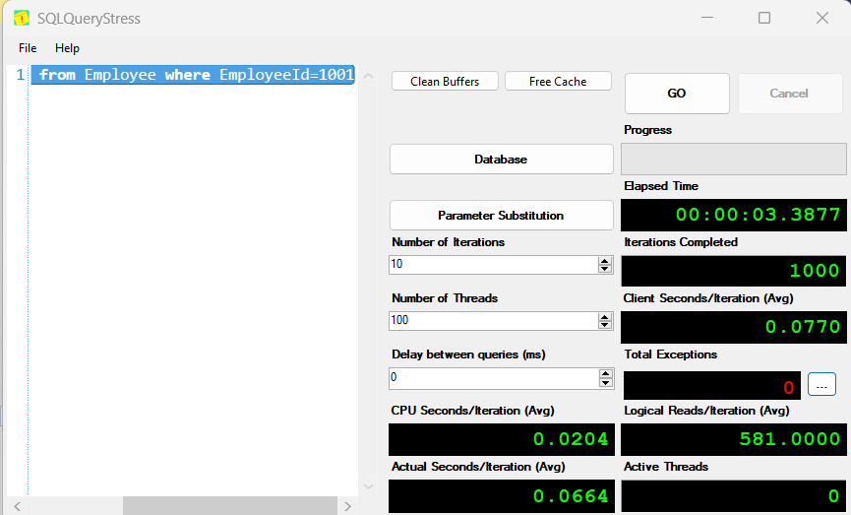
Load Tests without Index Column
Run the below query in SQL Stress test and note the timings
select FirstName from Employee where EmployeeId=1001

Slide 5
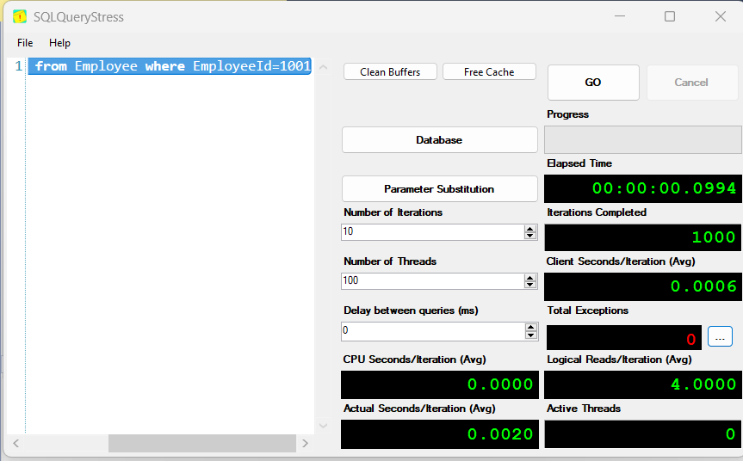
Load Tests with Index Column
Add an Index on Employee Id and now run the below query in SQL Stress test and note the timings
Create nonclustered index emp_in on Employee(EmployeeId)
select FirstName from Employee where EmployeeId=1001

